Slide 1


AI Care: AI Powered Health Assistance
Intelligent Multi-Agent Systems for Health Monitoring and Care Insights
Topic: High Rish Project - AI in Healthcare
Tool and Algorithms: Gemini Pro, Python, LangGraph, RAG Graph, LLM-Agents
Course: AI in Healthcare(AI 395T)
Professor: Dr. Ying Ding
Prepared By: Hemalatha Chandrasekar, Suresh Venkatesan
Notes:
Hello, everyone! I’m Hemalatha Chandrasekar, and with me is Suresh Venkatesan. Today, we’ll present our High-Risk project on AI in healthcare, focusing on AICare. This AI-powered health assistant uses technologies like Generative AI (Gemini-Pro), multi-agent systems, and knowledge graphs to provide personalized healthcare insights.

Slide 2

Overview
The rise of advanced artificial intelligence has transformed healthcare into a data-driven industry, enabling personalized and efficient patient care. AICare is an innovative AI-powered health assistance system that leverages generative AI models (Gemini-Pro⁺) and the MIMIC-III health dataset (Demo Data) to provide patient-centric insights and care.
This project introduces a multi-agent system designed to address various aspects of patient care, including retrieving medical history, assessing health risks, generating personalized recommendations, and summarizing complex medical text. The system utilizes a knowledge graph constructed from MIMIC-III data to represent patient information and their relationships with diagnoses, lab results, and medications. Four specialized agents – Query Response, Risk Assessment, Recommendation, and Summarizing Text – collaborate to provide comprehensive support. The Query Response Agent retrieves patient history from the knowledge graph. The Risk Assessment Agent analyzes this history to identify potential health risks using Gemini-Pro. Based on these risks, the Recommendation Agent generates personalized health advice. Finally, the Summarizing Text Agent condenses detailed medical information into concise summaries.
The system's performance is evaluated using standard NLP metrics such as BLEU, ROUGE, and METEOR scores to ensure accuracy and relevance. Additionally, human feedback is incorporated to further refine the system's responses. AICare demonstrates the potential of generative AI in enhancing healthcare delivery by providing timely, accurate, and personalized information to both patients and healthcare providers.
Notes:
Overview:
AICare is an AI-powered health assistance system leveraging generative AI models, knowledge graph and the healthcare dataset to deliver personalized patient care. It uses a multi-agent system with specialized agents for retrieving medical history, assessing risks, making recommendations, and summarizing medical information to improve and transform patient care.

Slide 3
Introduction
The volume of medical data is growing exponentially, necessitating the adoption of intelligent systems to assist clinicians in decision-making and patient management. Generative AI, with its contextual reasoning and language understanding, holds the potential to revolutionize healthcare delivery.
AICare aims to bridge the gap between raw clinical data and actionable insights by building a multi-agent system that employs the MIMIC-III dataset, a comprehensive database of patient health records. The project focuses on constructing a knowledge graph that organizes and interlinks patient and diagnosis data and integrates specialized agents for healthcare applications. These agents provide dynamic responses to patient queries, assess health risks, generate personalized health recommendations, and summarize complex medical texts.
Notes:
Introduction:
The rapid growth of medical data demands intelligent systems to assist clinicians in decision-making. AICare addresses this need by utilizing patient health datasets to create a multi-agent system powered by a knowledge graph that connects patient and diagnosis data, transforming the delivery of patient care.

Slide 4
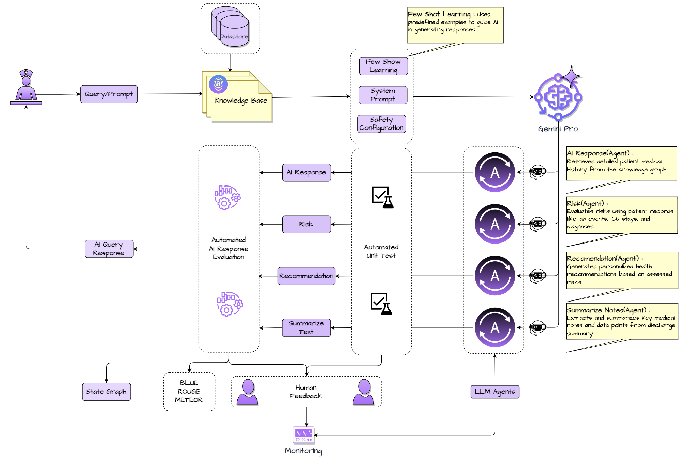
Process Flow Diagram
Notes:
Process Flow:
The AICare system leverages a multi-agent framework powered by generative AI (Gemini Pro) and a knowledge base constructed from patient health records. Key agents include the AI Response Agent, Risk Assessment Agent, Recommendation Agent, and Summarizing Text Agent, which collectively retrieve medical history, evaluate health risks, provide personalized recommendations, and condense medical notes. Few-shot learning ensures precise, context-aware outputs, while automated testing and human feedback refine system performance. AI responses are evaluated using metrics like BLEU, ROUGE, and METEOR, supported by continuous monitoring and state graph insights. The system exemplifies the integration of AI in personalized and efficient healthcare delivery.

Slide 5

Methodologies

Slide 6
Patients
Diagnosis
Notes
ICU Stays
Admissions
Drugs
Labs
Data Acquisition and Knowledge Graph Construction
The foundation of AICare is the MIMIC-III (Medical Information Mart for Intensive Care III) dataset, a publicly available critical care database. The dataset comprises various tables including patients, admissions, diagnoses, ICU stays, lab events, and prescriptions. Data preprocessing involved cleaning, removing duplicates, and ensuring data integrity. A knowledge graph was constructed to represent the relationships within the MIMIC-III dataset. Patients and diagnoses served as nodes, with edges representing "has_diagnosis" relationships. This graph facilitates efficient information retrieval and reasoning about patient medical history.
AICare utilizes the MIMIC-III health dataset, which includes critical patient information such as: Patient ID, Gender, Date of Birth (DOB), Date of Death (DOD), Admit Time, Discharge Time, Admission Type, Admission Location, Discharge Location, Insurance, Marital Status, Diagnosis, ICD9 Code, Drug, Lab Label, Chart Time, Lab Value, Lab Flag, Category, and Text(Discharge Summary).
Notes:
Data Processing:
The foundation of AICare is the health dataset, which includes patient demographics, diagnoses, ICU stays, lab results, and prescriptions. A knowledge graph was constructed from this data, linking patients and diagnoses as nodes with "has_diagnosis" relationships, enabling efficient retrieval and reasoning. Preprocessing ensured data quality, while the graph facilitates advanced analysis of patient medical history.

Slide 7
Example 1:
Patient ID: 83752
Context: Gender: Male, Age: 65, Diagnosis: Cardiac arrest
Medical History: Patient 83752 has the following diagnoses: 4275 (Cardiac arrest)
User Query: What are the patient's risks?
Response: The patient is at risk of heart failure due to the cardiac arrest.
Example 2:
Patient ID: 67890
Context: Gender: Female, Age: 70, Diagnosis: Acute kidney failure
Medical History: Patient 67890 has the following diagnoses: 5849 (Acute kidney failure)
User Query: What are the patient's risks?
Response: The patient is at risk of electrolyte imbalance and infection due to acute kidney failure.
Few-Shot Learning
Few-shot learning is a machine learning technique that allows AI models to learn from a small number of labeled examples, enabling them to make accurate predictions.
Notes:
Few-Shot Learning:
Few-shot learning is a machine learning technique that allows AI models to learn from a small number of labeled examples, enabling them to make accurate predictions.

Slide 8
Gen AI Safety Configuration
To mitigate the risk of generating harmful content, the Gen AI model is configured with the following safety filters:
Sexually Explicit Content: NEGLIGIBLE risk
Hate Speech: NEGLIGIBLE risk
Harassment: NEGLIGIBLE risk
Dangerous Content: MEDIUM risk
These filters help ensure that the model generates safe and appropriate responses.
Notes:
Gen AI Safety Configuration:
The Gen AI model is configured with various safety options to filter out harmful content.

Slide 9

Multi-Agent System Implementation
Query Response Agent: This agent is responsible for retrieving relevant patient information from the knowledge graph. Given a patient ID and query/prompt, it retrieves contextual information from the knowledge graph/base based on user-provided keywords and search criteria .
Risk Assessment Agent: This agent assesses potential health risks based on the patient's medical history. It leverages the Gemini-Pro API by formulating a prompt containing the patient's history and querying the model to identify potential risks. The generated response is then presented as the risk assessment.
Recommendation Agent: The agent focuses on providing personalized health recommendations. Similar to the Risk Assessment Agent, it constructs a prompt from the identified risks and generates specific preventative measures or recommendations for the patient.
Summarizing Text Agent: The agent is designed to summarize discharge summary notes, providing concise overviews of patient information. It provides the summary of the given text from the knowledge base, aiding in quick comprehension of complex medical records.
Query Handling and Response Generation: The Query Handling Agent orchestrates the interactions between the agents. It receives user queries, retrieves patient history, identifies keywords, and generates prompts for Gemini-Pro. The system utilizes a structured approach to prompt engineering, including system messages to guide Gemini-Pro's responses. The responses are then processed to extract plain text and checked for harmful content.
Notes:
Multi-Agent:
The Multi-Agent system in AICare includes the Query Response Agent, which retrieves patient information from the knowledge graph, and the Risk Assessment Agent, which evaluates potential health risks using patient history. The Recommendation Agent provides personalized health advice based on assessed risks, while the Summarizing Text Agent provides summary of medical notes for easier comprehension.

Slide 10

Results
Building Knowledge Graph
Multi-Agent Performance

Slide 11
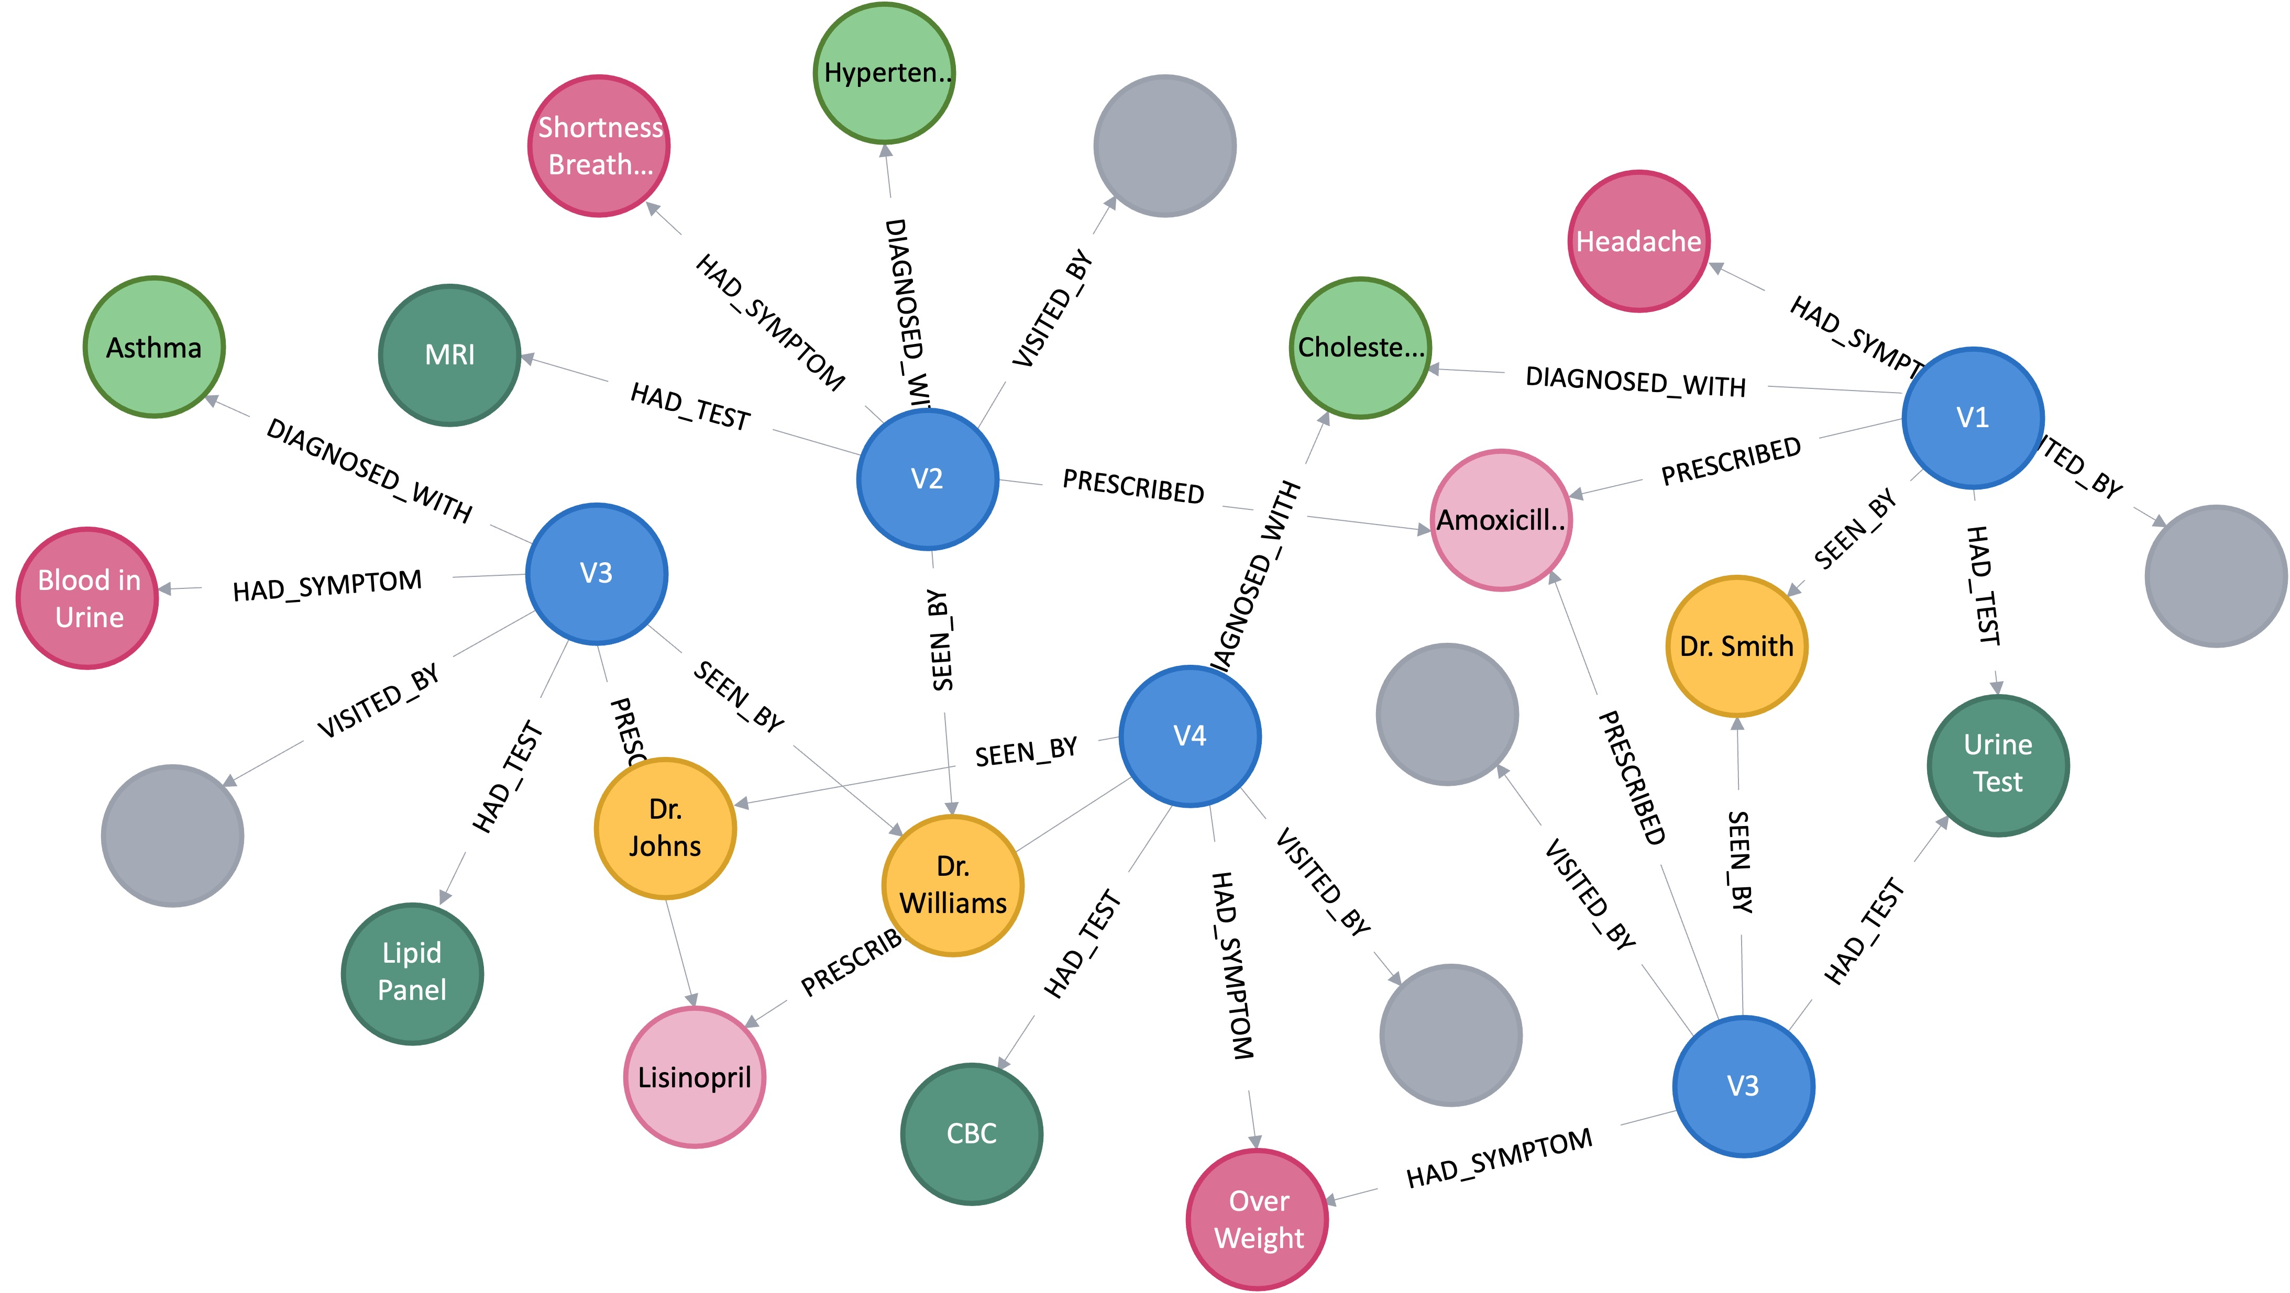
Node Type | Node ID | Attributes
Patient | 87525 | Gender: M, DOB: 1950-01-01, ... Diagnosis: 4275
Diagnosis | 4275 | Description: Cardiac Arrest, ... Lab Value: 100
Patient | 37924 | Gender: M, DOB: 1950-01-01, ... Diagnosis: 4275
Diagnosis | 5849 | Description: Acute Kidney, ... Lab Value: 100
Building Knowledge Graph
The knowledge graph, built from the MIMIC-III dataset, effectively represents the relationships between patients and their medical conditions. The graph structure enables efficient traversal and retrieval of patient data, essential for providing accurate and comprehensive responses to user queries. Visual representation of a subgraph (using a graph visualization library) highlights the connectivity between patients and their diagnoses.
Notes:
Knowledge Graph:
The knowledge graph, derived from health dataset, organizes relationships between patients and their medical conditions, enabling efficient data retrieval and query responses. Its structured design supports accurate insights, while visual subgraphs highlight the connections between patients and diagnoses.

Slide 12
Multi-Agent Performance

Slide 13
Query Response Agent
Example:
Patient ID: 87858
Query: What are the patient's diagnoses and risks?
Response: The patient's diagnoses include cardiac arrest, which could be characterized as a sudden and unexpected loss of heart function. Cardiac arrest is a life-threatening condition that requires immediate medical attention. The patient is at risk of serious complications, including death, if the condition is not treated promptly.
The agent successfully retrieves patient medical history from the knowledge graph. Example queries and responses are presented, showcasing the agent's ability to accurately extract diagnoses.
Notes:
Query Response Agent:
The agent efficiently retrieves patient medical history from the knowledge graph, with example queries and responses demonstrating its accuracy in extracting diagnoses.

Slide 14
Risk Assessment Agent
Risk Assessment Results:
Death: Cardiac arrest can lead to death if not treated promptly.
Brain damage: If the brain is deprived of oxygen during cardiac arrest, it can cause irreversible brain damage.
Organ damage: Other organs, such as the kidneys, liver, and heart, can also be damaged if they are deprived of oxygen during cardiac arrest.
Long-term disability: Cardiac arrest survivors may experience long-term disabilities, such as cognitive impairment, difficulty walking or speaking, and chronic fatigue.
The Risk Assessment Agent identifies risks based on patient histories from the health dataset and the knowledge graph, which are then used to evaluate the patient's risk.
Notes:
Risk Assessment Agent:
The Risk Assessment Agent identifies risks based on patient histories from the health dataset and the knowledge graph, which are then used to evaluate the patient's risk.

Slide 15

Example:
Preventive Measures and Recommendations:
CPR Certification: Take a CPR class to learn how to perform life-saving measures in case of cardiac arrest.
AED Availability: Ensure that AEDs (automated external defibrillators) are readily accessible in public spaces and workplaces.
Regular Check-ups: Schedule regular check-ups with a healthcare provider to monitor heart health and identify any risks.
Lifestyle Modifications: Adopt a healthy lifestyle that includes:
Regular exercise
Healthy diet
Stress management
No smoking
Moderate alcohol consumption
Recommendation Agent
The Recommendation Agent generates health recommendations based on assessed risks to improve patient care.
Notes:
Recommendation Agent:
The Recommendation Agent generates health recommendations based on assessed risks to improve patient care.

Slide 16
Example:
A female patient admitted on 2062-02-22 due to cardiac arrest passed away in the hospital on 2062-02-28. She was admitted through the Emergency Department after being referred from the clinic for premature admission. The patient was private insured and single. Her discharge location was deceased/expired. Several medications were administered during her stay, including Furosemide, Lorazepam, Morphine Sulfate, and Propofol
Summarizing Text Agent
This agent is responsible for summarizing medical notes based on the discharge summary for easier comprehension.
Notes:
Summarizing Text Agent:
This agent is responsible for summarizing medical notes based on the discharge summary for easier comprehension.

Slide 17

Evaluation

Slide 18

Metric | Score | Score Interpretation
BLEU | 0.91 | High precision and recall
ROUGE-1 | 0.73 | Strong overlap in unigrams
ROUGE-2 | 0.82 | Good overlap in bigrams
ROUGE-L | 0.84 | High longest common subsequence overlap
METEOR | 0.86 | Strong alignment and fluency
Evaluation Response Quality
The query responses are evaluated using BLEU, ROUGE, and METEOR evaluation metrics to assess the quality of generated text, such as translations or summaries, by comparing it to a reference. BLEU emphasizes precision by measuring word overlap, ROUGE prioritizes recall by evaluating how much relevant information is captured, and METEOR balances both precision and recall while incorporating word order and semantic alignment, often achieving a closer correlation with human evaluations than the other two metrics.
AICare successfully identified critical health risks for patients with chronic illnesses such as acute kidney failure and severe sepsis.
Summarization Agent reduced the verbosity of clinical and improving readability for healthcare providers.
Query Response Agent achieved a better accuracy for patient-specific queries.
Notes:
Evaluation Response Quality:
The query responses are evaluated using BLEU, ROUGE, and METEOR evaluation metrics to assess the quality of generated text, such as translations or summaries, by comparing it to a reference.

Slide 19

Automated Unit Test
Automated unit tests using health data for the LLM Agent system are performed to identify any potential issues whenever changes are made to the process for handling medical history, risk assessment, recommendations, knowledge retrieval, text summarization, and query handling.
Notes:
Unit Test:
Automated unit tests using health data for the LLM Agent system are performed to identify any potential issues whenever changes are made to the process.

Slide 20

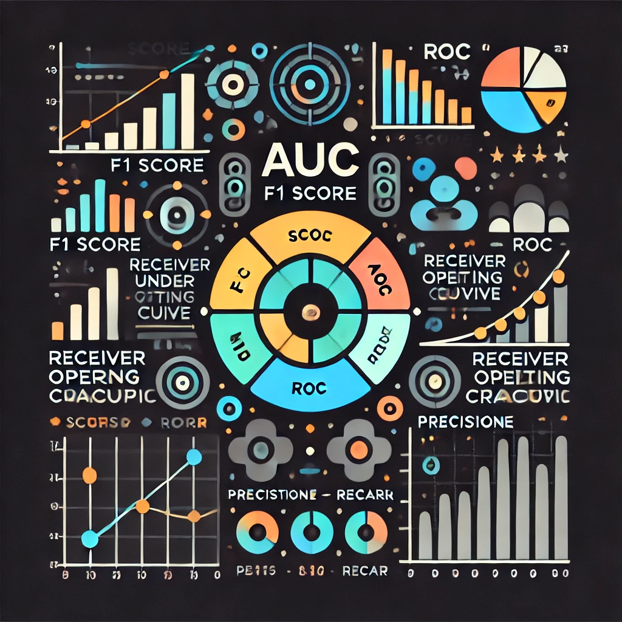
Metrics to Evaluate Accuracy
Use part of the MIMIC-III dataset for training (e.g., 80%) and the rest for testing (e.g., 20%) and compare the agent's predictions with established clinical models or expert-labeled data.
Precision: The proportion of correctly identified risks out of all risks predicted.
Recall: The proportion of actual risks correctly identified by the agent.
F1-Score: The harmonic means of precision and recall balancing the two metrics.
AUC-ROC Curve: Measures the ability of the model to distinguish between high and low-risk patients.
Notes:
Metrics to Evaluate Accuracy:
The dataset is divided into training (80%) and testing (20%) sets, with predictions compared to clinical models. Evaluation metrics like precision, recall, F1-score, and AUC-ROC are used to assess the agent's performance in identifying patient risks. These metrics provide a comprehensive evaluation of the agent's accuracy.

Slide 21
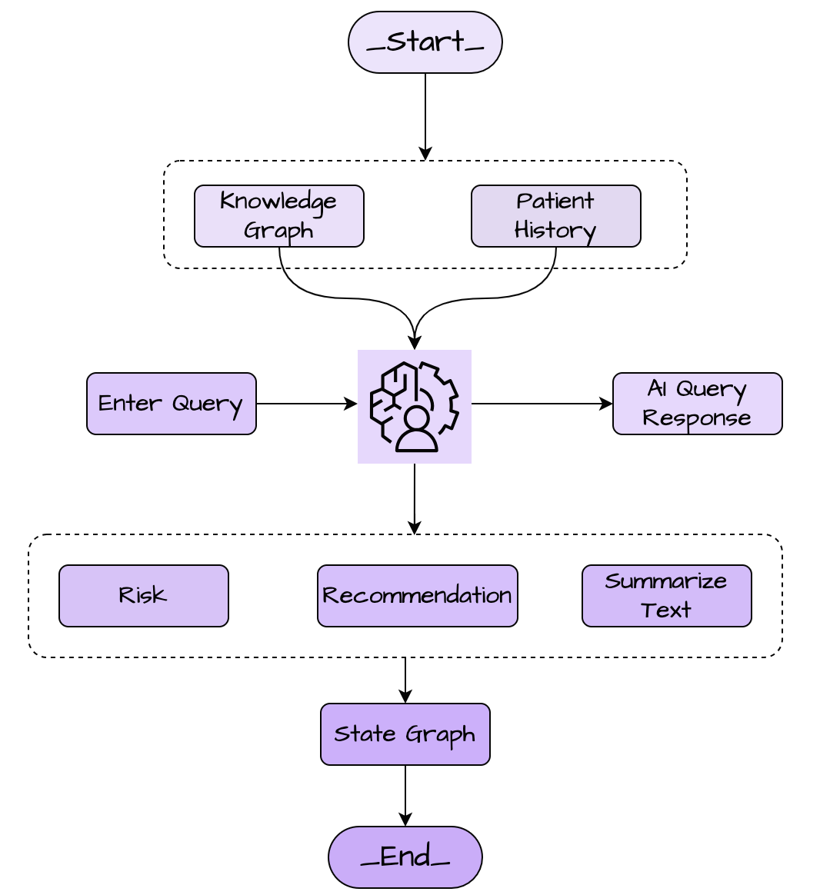
State Graph Diagram (Lang Graph)
This figure shows the workflow and interactions between the various agents, the knowledge graph, patient history, and Gen AI (Gemini-Pro) in the AICare system.
Notes:
State Graph:
This figure shows the workflow and interactions between the various agents, the knowledge graph, patient history, and Gen AI (Gemini-Pro) in the AICare system.

Slide 22
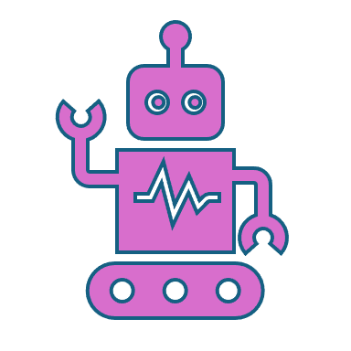
Conclusions
The AICare system demonstrates significant potential for enhancing healthcare assistance using generative AI. Integrating Gemini-Pro with a knowledge graph derived from the MIMIC-III dataset enables a robust and informative system capable of providing personalized medical insights. The multi-agent architecture proves highly effective in managing different aspects of medical information processing. Each agent performs a specialized task, contributing to a comprehensive and coherent response to user queries. The Query Response Agent successfully retrieves patient history, providing the necessary context for subsequent agents. The Risk Assessment and Recommendation Agents, powered by Gemini-Pro, deliver valuable insights and actionable advice, showcasing the model's ability to interpret medical information. The Summarizing Text Agent effectively condenses complex medical information, facilitating quick comprehension for both healthcare providers and patients.
Notes:
Conclusions:
The AICare system demonstrates strong potential in enhancing healthcare with generative AI, leveraging Gemini-Pro and knowledge graph for personalized insights. Its multi-agent architecture efficiently manages medical information processing, with each agent specializing in tasks like risk assessment, recommendations, and text summarization. The system successfully retrieves patient history and provides actionable, concise medical insights for both healthcare providers and patients.

Slide 23

Human Feedback and System Refinement
The incorporation of a human feedback mechanism is crucial for ongoing system improvement. Feedback allows for iterative refinement of the agent prompts and responses, ensuring alignment with real-world healthcare needs and addressing potential biases in the AI model. This continuous improvement loop is essential for building trust and reliability in the system.
Notes:
Human Feedback:
The system requires human feedback to continually improve. This feedback helps refine AI prompts and responses, ensuring alignment with real-world healthcare needs and addressing potential biases. This continuous improvement process is crucial for building trust in the system.

Slide 24
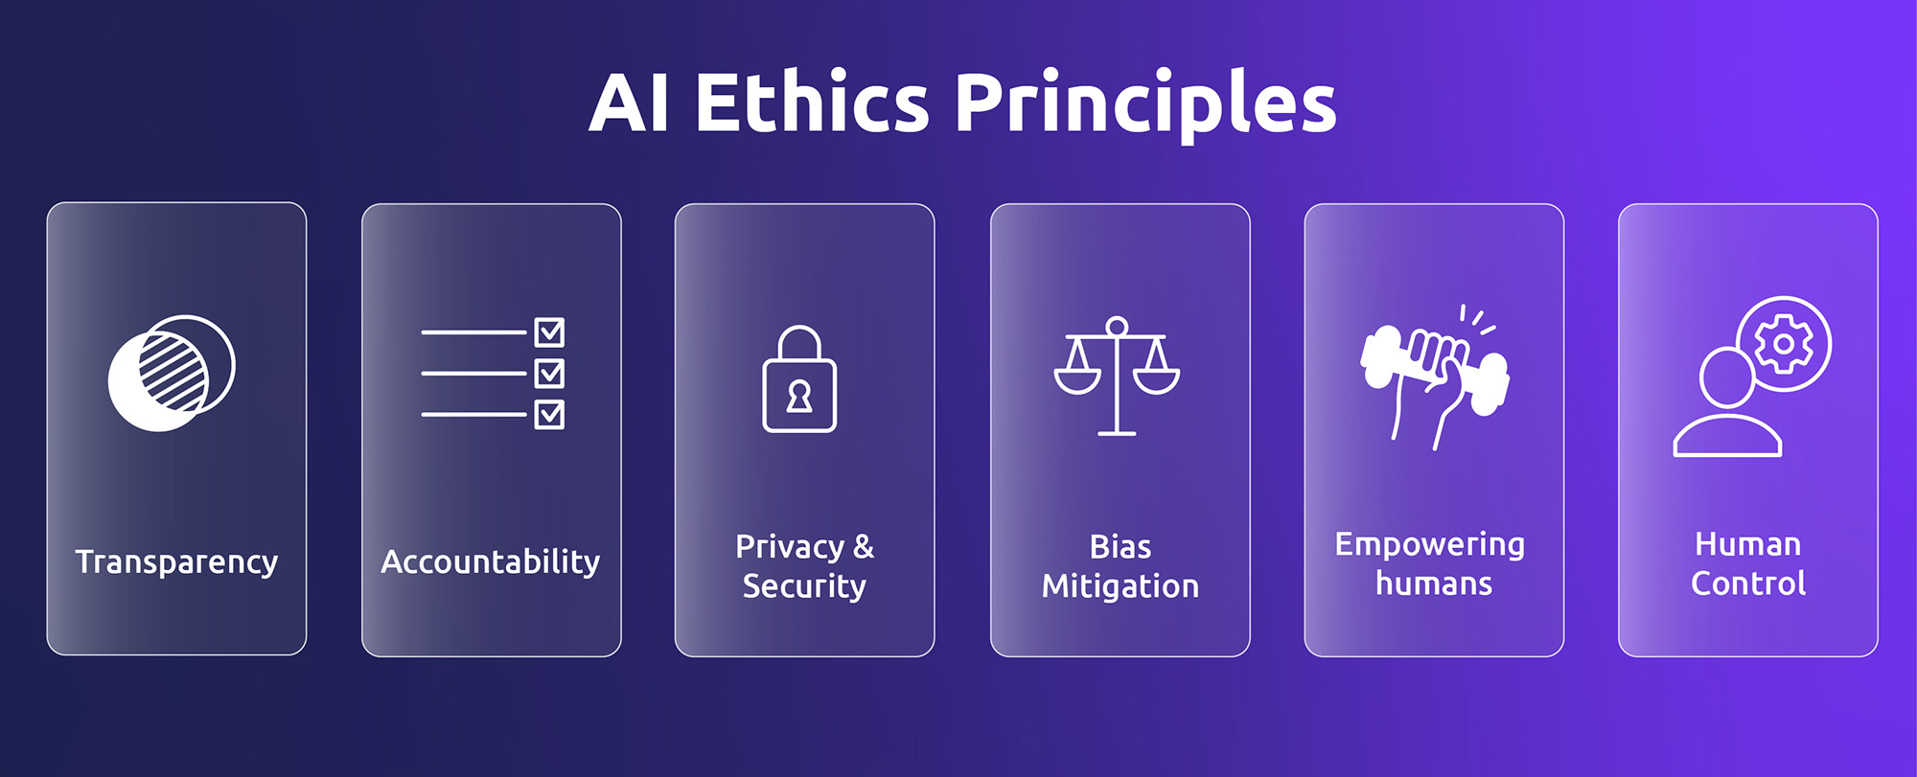
Ethical Considerations
As with any AI-driven healthcare system, ethical considerations are paramount. Data privacy and security are critical, and all patient data must be handled with strict adherence to privacy regulations. Transparency in how the system operates and how decisions are made is also essential to foster trust and acceptance among users. Furthermore, addressing potential biases in the AI model is a continuous process, requiring ongoing monitoring and evaluation.
Notes:
Ethical Considerations:
The AI system must prioritize data privacy and security, and be transparent in its operations. Additionally, it's crucial to continuously monitor and address potential biases in the AI model to ensure fairness and accuracy in its decision-making.

Slide 25

Summary of Key Findings
Effective Multi-Agent Architecture: The specialized agents demonstrate effective collaboration, delivering comprehensive medical insights.
Gemini-Pro's Interpretive Capability: The generative model effectively interprets medical data, assessing risks and generating relevant recommendations.
Knowledge Graph Utility: The knowledge graph representation enables efficient retrieval and reasoning about patient medical history.
Human Feedback Loop: The incorporation of human feedback is essential for refining system responses and addressing AI biases.
Positive Evaluation Metrics: The BLEU, ROUGE, and METEOR scores demonstrate strong alignment and fluency of the generated text.
Notes:
Key Findings:
The AICare system uses a multi-agent architecture for comprehensive medical insights, with Gen AI interpreting data for risk assessment and recommendations. The knowledge graph supports efficient data retrieval, while human feedback and positive evaluation metrics ensure continuous improvement and response accuracy.

Slide 26
Challenges & Limitations
Data Bias and Generalizability: The system's performance is dependent on the data it is trained on. Biases in the MIMIC-III dataset could limit the system's generalizability to other patient populations.
Complexity of Medical Language: NLP in healthcare is inherently challenging due to the complexity and ambiguity of medical terminology.
Computational Resources: Generative AI models like Gemini-Pro require significant computational resources, potentially posing challenges for scalability and cost-effectiveness.
Hallucinations and Accuracy: Generative models can sometimes generate acceptable content but inaccurate information ("hallucinations"), which is a crucial area for ongoing improvement. Thorough validation and verification are essential.
Notes:
Challenges & Limitations:
The system's performance can be limited by data bias and the complexity of medical language. Additionally, computational resource requirements and potential hallucinations in generative models pose challenges for scalability and accuracy.

Slide 27

Future Directions
Enhanced Knowledge Graph: Expanding the knowledge graph to include more diverse data sources (e.g., lab results, medications, family history) will provide a more holistic view of patient health.
Real-time Data Integration: Integrating real-time patient data from electronic health records (EHRs) would enhance the system's ability to provide up-to-date information and support.
Explainable AI (XAI): Incorporating XAI techniques would allow the system to explain its reasoning behind risk assessments and recommendations, fostering greater trust among users.
Clinical Trials and Validation: Conducting clinical trials to rigorously validate the system's accuracy and effectiveness in a real-world healthcare setting is essential for wider adoption.
Multilingual Support: Extending language support will increase accessibility and make the system more applicable in diverse patient populations.
Integration with Wearable Devices: Connecting the system with wearable health trackers can provide real-time monitoring and personalized interventions.
Notes:
Future Direction:
The system can be enhanced by expanding the knowledge graph, integrating real-time data, and incorporating explainable AI. Conducting clinical trials and multilingual support will increase its applicability. Additionally, integrating with wearable devices can provide real-time monitoring and personalized interventions.

Slide 28
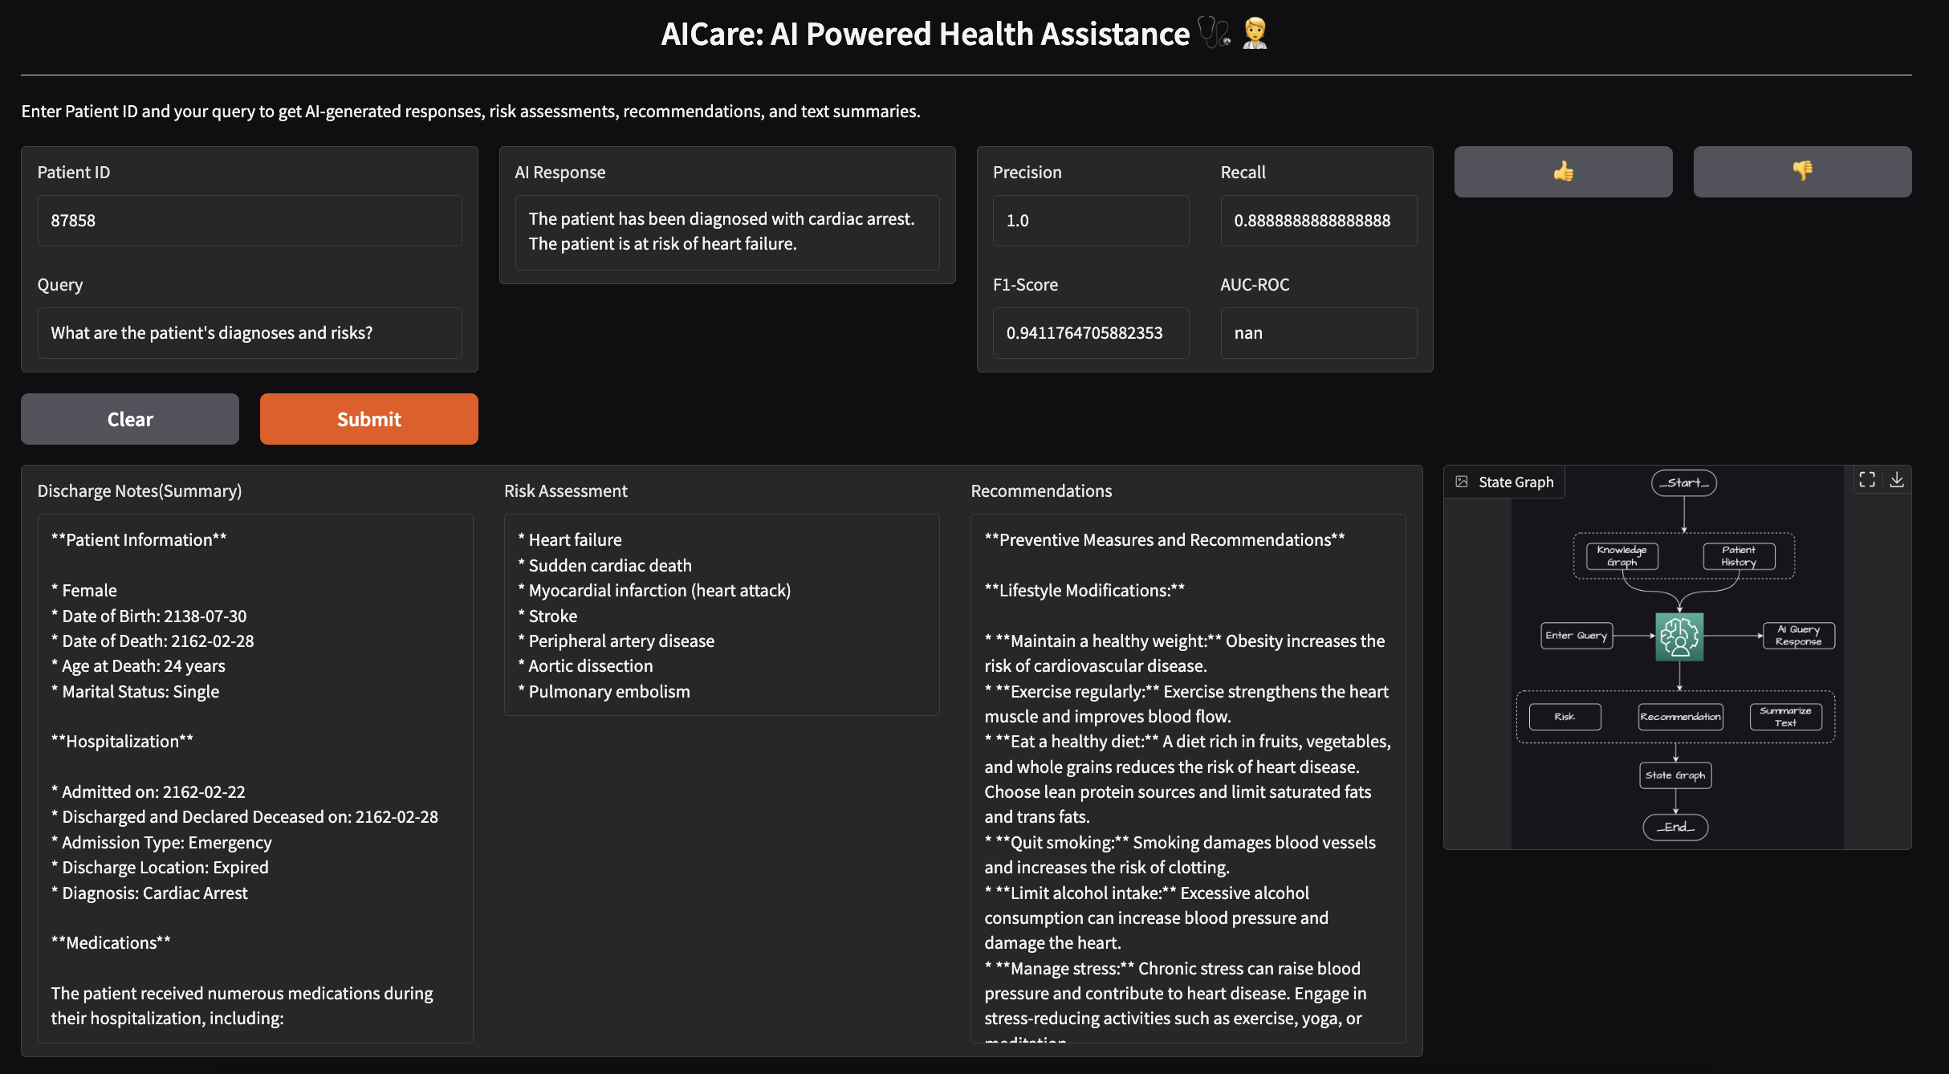
Demo
User Interface
Notes:
Demo & User Interface:
This is the UI for AICare, an AI-powered healthcare assistant. Users input a patient ID and query to receive AI-generated responses, risk assessments, recommendations, and text summaries. The system analyzes patient data, identifies potential risks, and provides tailored recommendations. A state graph visualizes the system's workflow. Additionally, feedback mechanisms allow for continuous improvement and refinement of the AI-powered responses.

Slide 29

Thank You

Slide 30
References
[1] Huang, K., et al. "Knowledge Graphs in Personalized Medicine." Nature Reviews Drug Discovery, 2019.
[2] Zhang, Y., et al. "Automatic Summarization of Clinical Notes Using NLP." Journal of Biomedical Informatics, 2020.
[3] Johnson, A. E. W., et al. "MIMIC-III: A Freely Accessible Critical Care Database." Scientific Data, 2016.
[4] Papineni, K., et al. "BLEU: A Method for Automatic Evaluation of Machine Translation." ACL, 2002.
[5] Lin, C. Y. "ROUGE: A Package for Automatic Evaluation of Summaries." ACL, 2004.Conference Name:ACM Woodstock conference
[6] Cianfanelli, L., et al. "A Multi-Agent Architecture for Healthcare Applications" 2010.
[7] Li, M., et al. "A Multi-Agent System for Intelligent Patient Monitoring and Alert Management in Intensive Care Units" 2018.

